Slide 1
From Zero to Pipeline
My Journey with GitHub Copilot, Terraform & Ansible
Danny de Haan · { devConf } · March 2026
#GitHubCopilot #Terraform #Ansible #DevOps #AI

Slide 2
From Zero to Pipeline
My Journey with GitHub Copilot, Terraform & Ansible
EXPERIMENT
Danny de Haan · { devConf } · March 2026
#GitHubCopilot #Terraform #Ansible #DevOps #AI

Slide 3




Introduction
Danny de Haan
Solutions Engineer
🌐 thatinfradba.com 📧 thatinfradba@pm.me 💼 /dannydh

Slide 4
What We'll Cover
→ AI Fundamentals - How LLMs work & their limits
→ Bridging the Gap - RAG, context & keeping models current
→ Agents & Tool Use - When AI goes from answering to doing
→ Copilot Deep Dive - Prompt files & instruction markdown
→ My Journey - From zero to a working pipeline
→ Lessons & Takeaways - What you can apply today

Slide 5
🚀 My Journey with GitHub Copilot
From zero to working pipeline

Slide 6
Starting Point
📌 Where I started: zero Terraform / Ansible knowledge
📌 What the goal was: test & demo deployment pipeline
📌 Very first interaction with Copilot: How to tackle a project this size?

Slide 7
The Challenges
📌 Specific roadblocks: My limited knowledge, AI repeating mistakes
📌 Moments Copilot was confidently wrong: Usage of WinRM
📌The moment things “clicked”

Slide 8
🧠 AI Fundamentals
The quick version: just enough to use it well

Slide 9
What is an LLM?
What it actually is:
What it is not:
• Trained on massive text datasets • Learns to predict the next token • Billions of parameters: compressed patterns • Stateless: no memory between sessions
✗ A database or search engine ✗ Always correct ✗ Aware of anything after its training cutoff
✗ Able to run or test its own code
💡 Think of it as a very well-read colleague who hasn't checked the internet in a while

Slide 10
The Knowledge Cutoff Problem
Models are trained up to a point in time - then frozen.
What this means for DevOps
The solutions
• May not know Terraform 1.9+ features • New Ansible modules may be unknown • Recent GitHub Actions runner syntax gaps • New provider versions & breaking changes
• RAG - inject fresh docs at query time • Context window - paste docs directly in • Web search tools (in agent mode) • Instruction files with version pinning

Slide 11
Bridging the Gap: RAG
Retrieval Augmented Generation: giving the model fresh context at query time
📥User Query
🔍Search Knowledge Base
📎Inject Results
🧠 LLM Answers
→
→
→
In Copilot this looks like:
DIY RAG for DevOps:
• @workspace scans your entire repo • #file attaches specific files • Open editor tabs add implicit context • Copilot fetches live external data
• Paste Terraform provider docs into chat • Include module README in your prompt • Drop error output directly in the message • Reference your own existing playbooks

Slide 12
🤖 Agents & Tool Use
When AI goes from answering to doing

Slide 13
What is an AI Agent?
Model + Loop + Tools. That's it.
📥 User Goal
🧠Reason
🔧 Pick Tool
⚙️Execute
👀 Observe
✅ Done/Loop
→
→
→
→
→
This is the ReAct loop:
Key insight for DevOps:
Reason → Act → Observe → Repeat The model decides when to stop, not you.
The agent can read your code, run a command, see the error, fix it, re-run; without you in the loop.

Slide 14
Tool Use in Practice
The model emits a structured call, the runtime executes it, result goes back into context.
Common agent tools:
// Agent decides to run this: { "tool": "runTerminalCommand", "input": { "command": "terraform plan" } } // Gets back exit code + stdout // Reasons: errors? → fix → re-run // OR: looks good → terraform apply?
• read_file / write_file • run_terminal_command • web_search • create_pull_request • run_tests / get_test_results • call_api (custom extensions)

Slide 15
Agents in Your DevOps Workflow
Copilot Agent Mode (VS Code)
Real prompts that work:
• Explores your repo via @workspace • Writes & edits files autonomously • Runs terminal commands, reads output • Iterates on errors without prompting • Can trigger builds & tests
• "Write a Terraform module that clones a Proxmox VM template and joins it to the domain" • "The Ansible playbook fails on the WinRM connection - fix it and re-run" • "Create a GitHub Actions workflow that runs Terraform plan, then Ansible, on push to main"
⚠️ Agents can make mistakes - and they can move fast. Always review before applying to real infra.

Slide 16
The Trust Calibration Problem
Especially relevant when you're learning the tech alongside the tool
Where Copilot shines:
Watch out for:
• Boilerplate & scaffolding • Well-established patterns (S3, EC2, etc.) • Explaining existing code in plain English • Translating intent into HCL / YAML • Generating tests & docs
• Outdated provider versions & attributes • Hallucinated resource arguments • Overly permissive IAM defaults • "Confident but wrong" - no uncertainty signal • Security anti-patterns presented as normal
💡 Ask Copilot to explain its own output. If it can't, that's a red flag.

Slide 17

Copilot Deep Dive
Teaching Copilot how to behave in your environment

Slide 18
How Copilot Builds Its Context
Every suggestion is shaped by what's in the context window at that moment
📂 Open Files Current file + open editor tabs
📋 Instruction Files Your rules, always included
🔍 @workspace Repository content
💬 Chat History This session's conversation
🧩 Extensions Live external data sources
📎 #file Manually referenced content
The instruction files are the only part of this you fully control upfront: make them count!

Slide 19
The Repo Instructions File
.github/copilot-instructions.md >> automatically injected into every Copilot Chat request
Think of it as:
# Copilot Instructions ## Project Context Infra repo for test/demo envs on Proxmox VE. Stack: Terraform + Ansible + GitHub Actions. ## Terraform - Always use modules - Proxmox provider: bpg/proxmox - snake_case for all resource names - Tag every VM: env, owner, project ## Ansible - Every task MUST have a name - Use FQCN (e.g. ansible.builtin.copy) - Prefer idempotent tasks ## Do NOT - Suggest hardcoded secrets - Use the deprecated telmate provider
• Your automated team style guide
• Onboarding docs for an AI colleague • Version controlled & PR-reviewable • Gets better with every iteration
💡 More specific = better suggestions. Tell it your exact stack, versions, and conventions.

Slide 20
Prompt Files
.github/prompts/*.prompt.md >> reusable, task-specific instructions you invoke on demand
terraform-module.prompt.md
ansible-role.prompt.md
Create a new Terraform module: ## Files required - main.tf — resource definitions - variables.tf — typed + described vars - outputs.tf — meaningful outputs - README.md — terraform-docs format ## Rules - All variables need descriptions + types - Use lifecycle { prevent_destroy = true } for stateful resources - Assume AWS provider ~> 5.0 - No hardcoded region; use var.aws_region
Generate an Ansible role for [ROLE_NAME]: ## Structure roles/[ROLE_NAME]/ tasks/main.yml defaults/main.yml handlers/main.yml templates/ (if needed) ## Rules - Descriptive name on every task - FQCN module names throughout - Register results where meaningful - Add when: conditions for OS variants - No hardcoded values — use defaults/

Slide 21
Prompt Files in Practice
/terraform-module Module name: vpc Resource type: aws_vpc
Why this matters:
Useful prompt files for DevOps:
• Consistent output across the whole team • Encodes your standards, not defaults • Reviewable & improvable via PRs • Reusable across projects
• new-pipeline.prompt.md • security-review.prompt.md • write-readme.prompt.md • debug-terraform.prompt.md • ansible-role.prompt.md • new-github-action.prompt.md

Slide 22
Writing Good Instructions
Same rules as a good prompt, just persistent and team-shared
✗ Vague | ✓ Specific
"Use good naming" | "snake_case. Prefix env resources: dev_, prod_, staging_"
"Follow security practices" | "Never hardcode creds. Use data.aws_secretsmanager_secret"
"Write good tasks" | "Every task has a name. Use FQCN. Register results."
"Use modules" | "Use terraform-aws-modules. AWS provider ~> 5.0 only."
💡 Start by writing down what frustrates you most about Copilot's defaults.
Then fix it in the instructions file.

Slide 23
🚀 My Journey with GitHub Copilot
What did we end up with?

Slide 24
Infrastructure Architecture
GitHub
Management Segment
Proxmox Node
repository
Workflows / Terraform / Ansible
Domain YAML configs
Self-Hosted Runner
Linux VM
bash / terraform / ansible / pywinrm
VM Templates
Windows Server 2022 / Windows Server 2025
workflow jobs
Proxmox API
Terraform clone
Vault API
credentials
Ansible
Deployed Domains (per run)
GitHub Secrets
Vault unseal keys
Vault AppRole credentials
Vault Host (Docker)
HashiCorp Vault
AppRole auth
Secrets store
Domain A (e.g. Green)
Domain B (e.g. Purple)
Domain Controller
AD DS / DNS
Domain Controller
AD DS / DNS
SQL Server(s)
SQL 2019 / 2022 / 2025
Optional: WSFC + AG
SQL Server(s)
SQL 2019 / 2022 / 2025
App Server(s)
IIS / Redgate Monitor
App Server(s)
IIS / Redgate Monitor

Slide 25
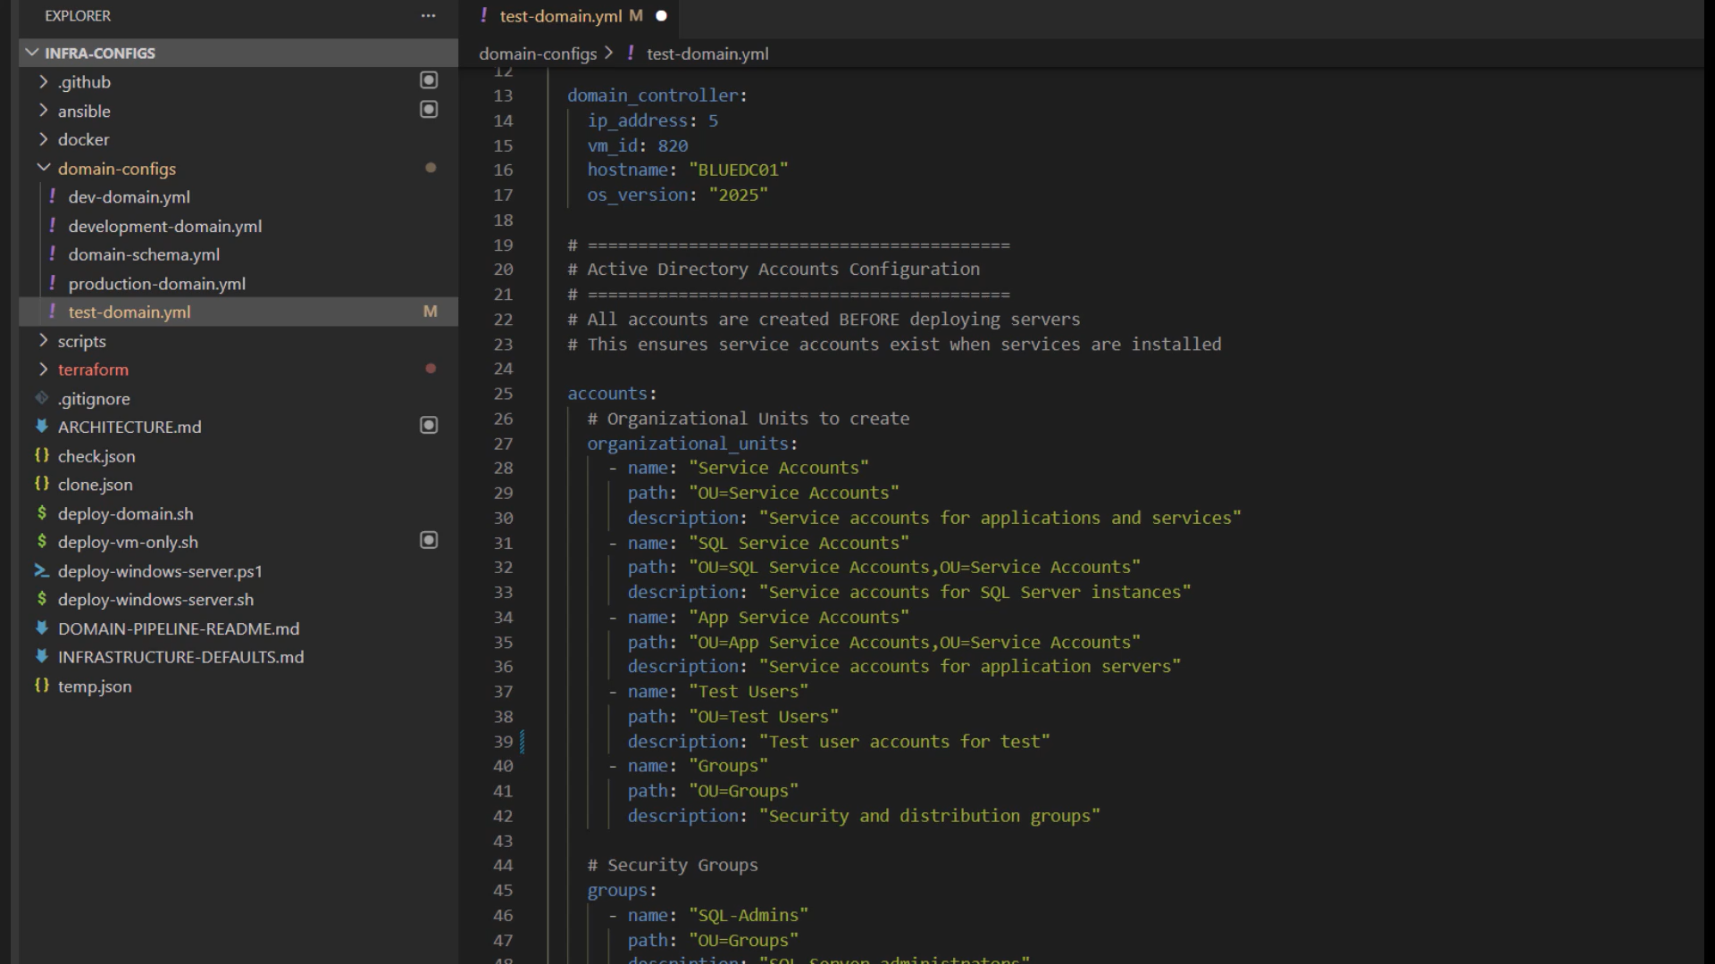
Domain Configuration Files

Slide 26
The Pipeline
📌 Terraform Structure
📌deploy-domain
📌vm-{ID} specific
📌 Ansible Playbooks
📌 configure objects
📌 configure sql
📌 configure iis
📌 GitHub Actions Pipeline

Slide 27
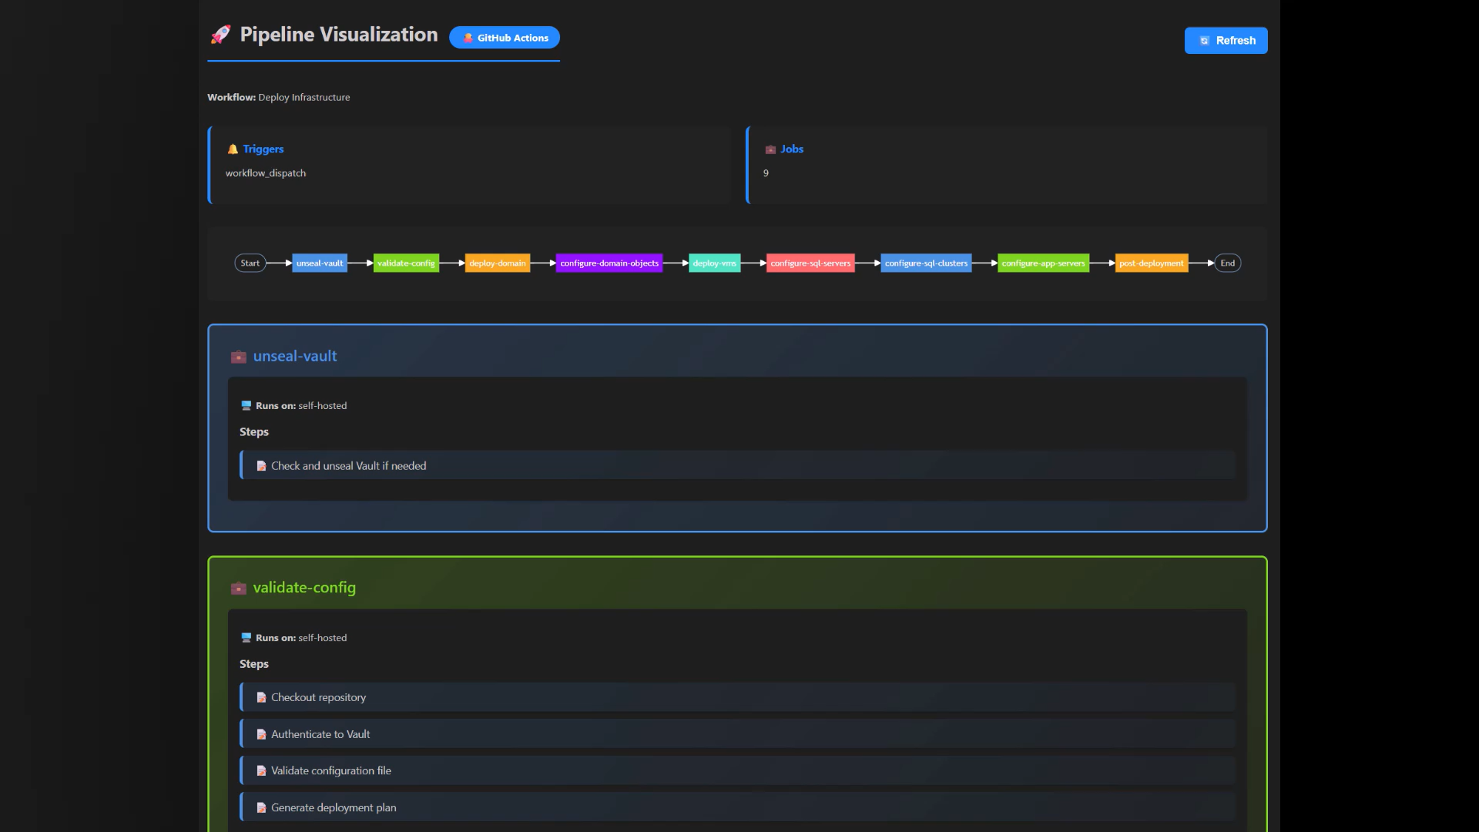
GitHub Actions Pipeline

Slide 28
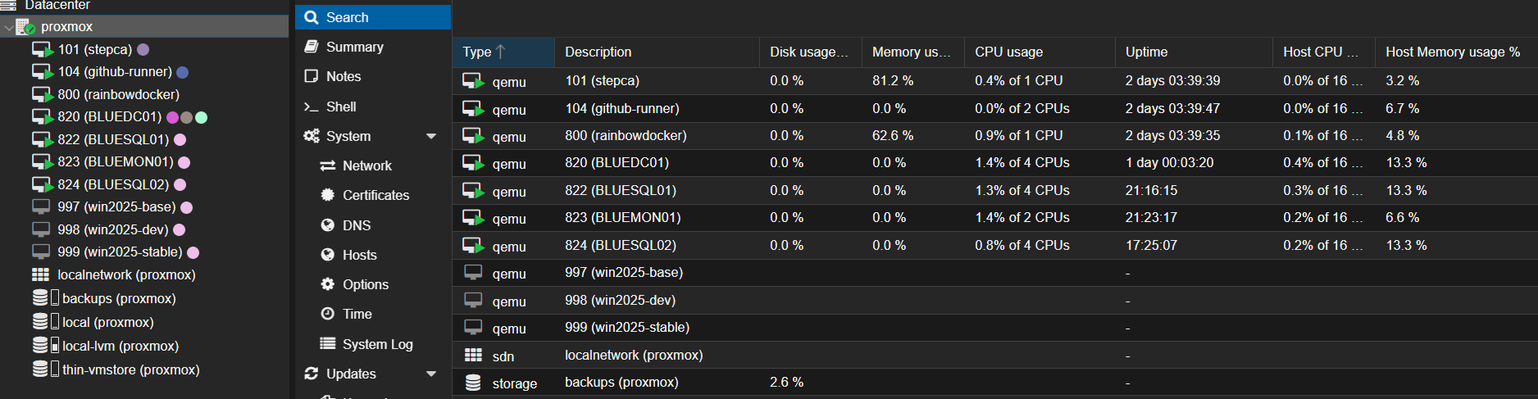
Proxmox

Slide 29
Proxmox

Slide 30
The Future Plans
📌Redo the entire project
📌Switch to Claude
📌Integrate Packer
📌Stability Improvements

Slide 31
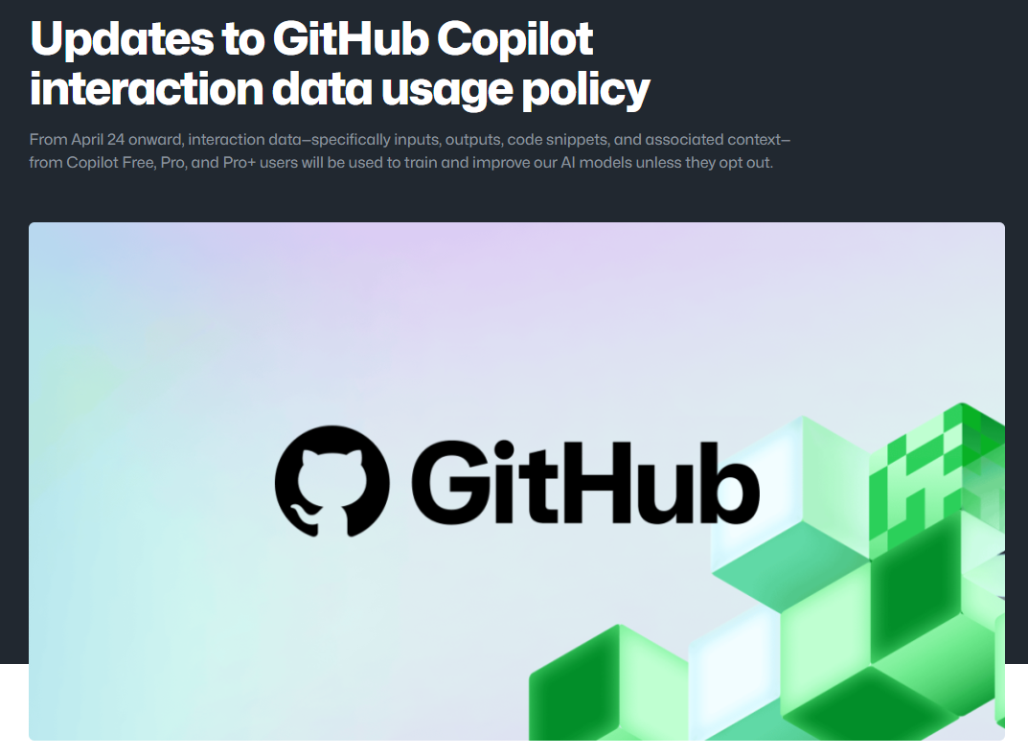
A small warning
https://github.blog/news-insights/company-news/updates-to-github-copilot-interaction-data-usage-policy/

Slide 32
Lessons Learned
→ Context is everything: garbage in, garbage out.
More specific prompt = better output.
→ Instructions file fundamentals: invest early, save hours
later, across the whole team.
→ Trust but verify; always read the code Copilot writes.
You're still the engineer.
→ Prompt files = team infra: treat them like code.
Review, iterate, improve.
→ Use it to learn, not skip learning: "explain this" is as
powerful as "generate this".
→ It's a peer, not an oracle; push back, question it,
run its output.

Slide 33
What You Can Apply Today
Create .github/copilot-instructions.md Even 10 lines of your conventions will meaningfully change Copilot's output
1
Write one prompt file for your most common task New module? New playbook? New pipeline? Codify that pattern once, use it forever.
2
Use Copilot to learn, not just generate "Explain this Terraform plan to me" is just as valuable as "write this for me"
3
Try Agent Mode for one real task end-to-end Give it a concrete goal, watch the loop, then carefully review before you apply
4

Slide 34

Thank You!
🌐 thatinfradba.com · 📧 thatinfradba@pm.me · 💼 /dannydh

